Slide 1
Docker in AWS ECS

Slide 2


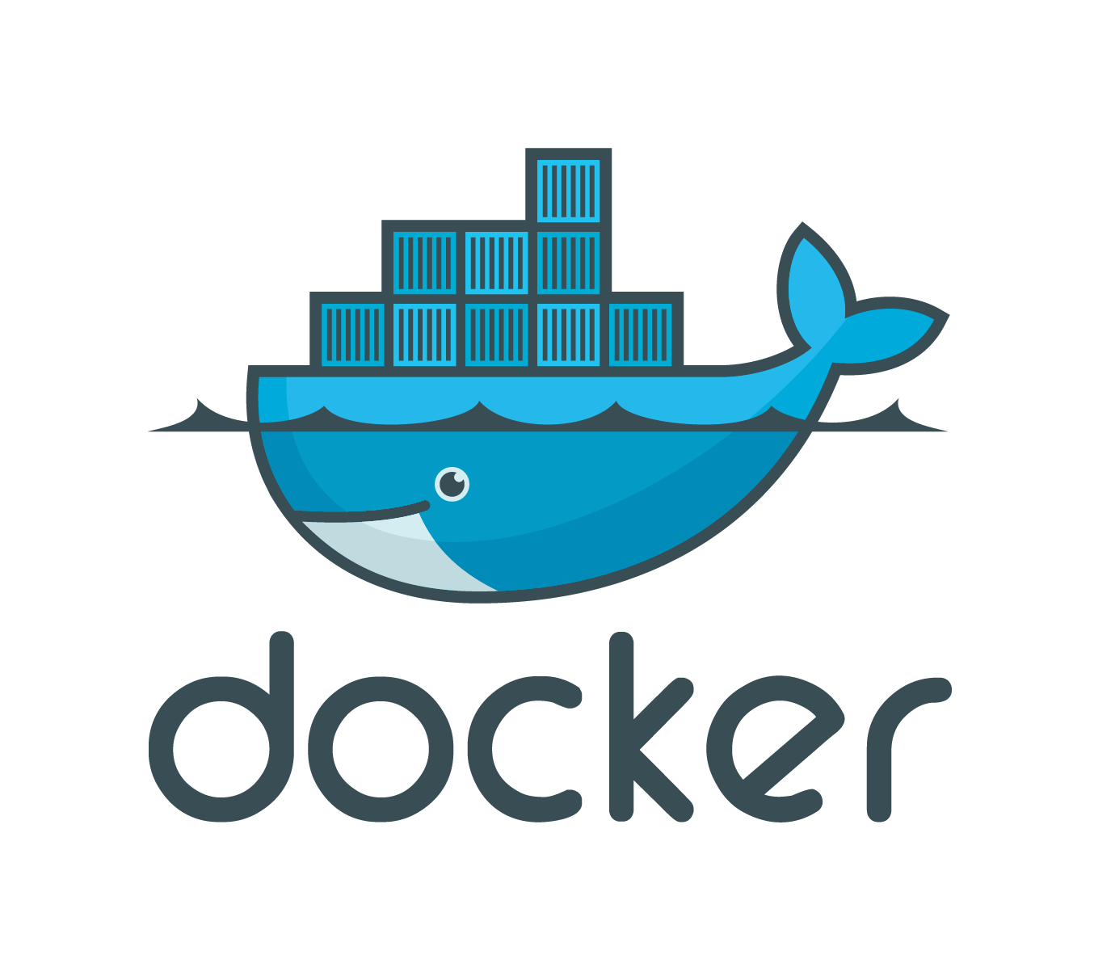
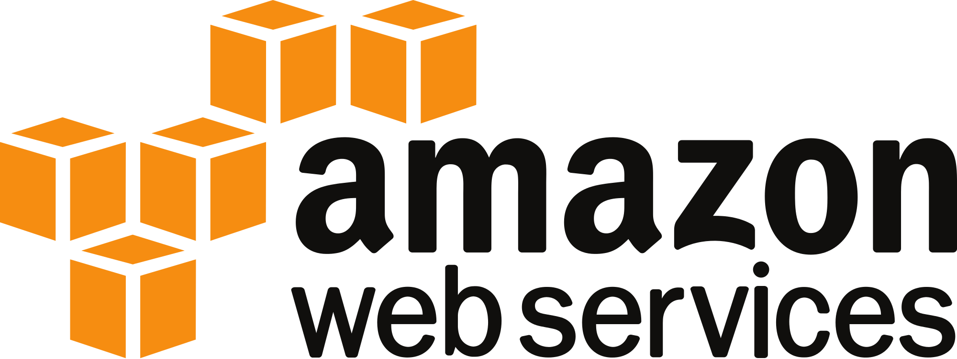
Recap
Infrastructure Goals
PaaS in AWS
Less infrastructure management
Docker
Consistent across environments
Fast to deploy
Less cost
DB Credentials
Test
Build
Deploy
S3
Jenkins
Pipeline
ECS

Slide 3



Recap
Deployment Pipeline Goals
Easy deployment of code
Easy access to logs*
* not implemented yet
Application Code
Easy Button
Test / Production

Slide 4
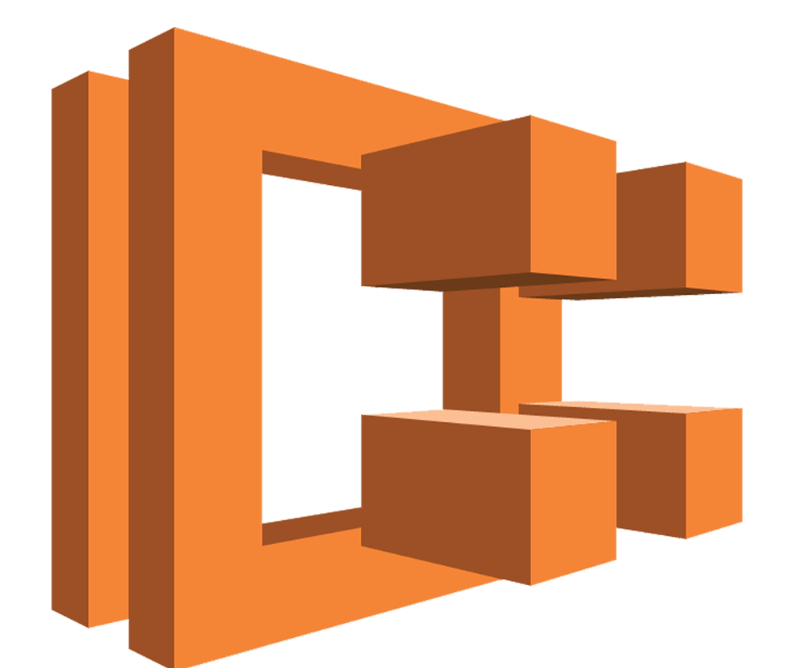
ECS
EC2 Container Service - Docker PaaS in AWS
Docker image → AWS → ??? → Done
ECS
Easy Button
Test / Production

Slide 5
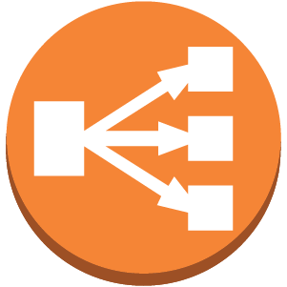



???
What’s under the hood
Amazon ECS Optimized AMI
Web Traffic
ECS Host Instances
- Cluster
- Service
Target Group
Application Load Balancer
Auto Scaling Group
Docker Image
ECS
Launch Configuration
Database Credentials
Role Permissions
Role Permissions
Application Logs
Task Definition, Container Definition
S3
ECS Repository
CloudWatch
IAM
Docker Image
Easy Button
Permissions

Slide 6
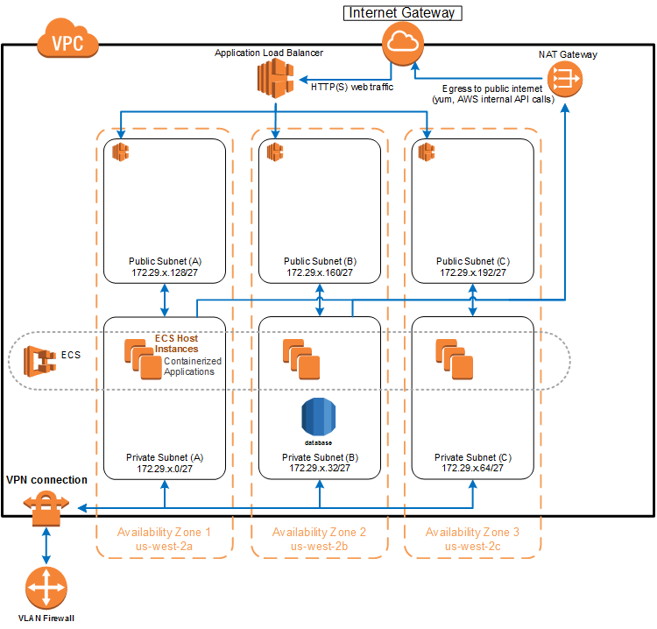
???
What’s under the hood
You already have a VPC, right?

Slide 7
Additional Resources
Microsoft Ignite - Explanation of containers (~15 minutes)
https://youtu.be/ximW1iMaUwE?list=PLQXpv_NQsPID4zHh5df2jkhPQ6R9Aon_S&t=3529
AWS Blog - Managing Secrets for Amazon ECS Applications
https://aws.amazon.com/blogs/compute/managing-secrets-for-amazon-ecs-applications-using-parameter-store-and-iam-roles-for-tasks/

